Slide 1

Visuals to support Bible Study
Isaiah: October 2021

Slide 2
Judah | Israel | Assyria | Egypt
Uzziah (783‐742) Prophet Isaiah | Jeroboam II (786‐ 746) Zechariah 746‐745 |  | 22nd Dynasty (ca. 935‐725)
Jotham (co‐regent ca. 750; 742‐735) | Shallum (745) Menahem (745‐737) Pekahiah (737‐736) | Tiglath‐pileser III (745‐727) | 23rd Dynasty (ca. 759‐715) 24th Dynasty
Ahaz (co‐regent 735; 732‐716 | Pekah (736‐732) Hoshea (732‐724) Fall of Samaria (722/1) | Shalmaneser V (726‐722) Sargon II (721‐705 | 25th Dynasty (Ethiopian, ca. 725‐ 664 BC) Shabako (ca. 710/9 to 696/5) Tirhaka (690 to 664
Hezekiah (715‐ 687/6) |  | Sennacherib (704‐ 681, invades in 701)

Slide 3
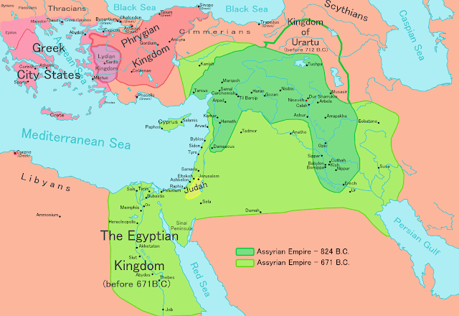

Slide 4
